Slide 1
Tile Survivor
Mobile Game Pitch Presentation
Joao Francisco Nunes Codices
CMP6187 - Mobile Game Development
Computer Games Technology
Birmingham City University

Slide 2
Game Premise
HyperCasual Endless Survival Game
A game where the player must survive for as long as possible moving between a set of tiles.
The player must collect coins to increase its score and use in the store for a better change at getting a higher score.
They also must dodge falling objects that do damage to the player. These objects may also block tiles decreasing the available gameplay area.
The longer the player lasts the faster and harder the game gets.

Slide 3
Game overview
Game Genre: HyperCasual
Design Principles:
Player can quickly open and start playing game.
High replay ability given randomized nature of gameplay.
Challenging due to increasing difficulty based on player ability.
Game Engine : Unity
Target Audience: short period casual players looking for difficulty without too much complexion
Publishing Platform: Itch.io/ Google Play Store

Slide 4
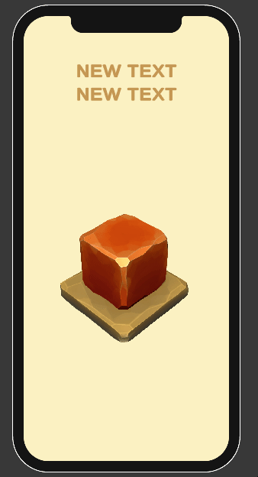
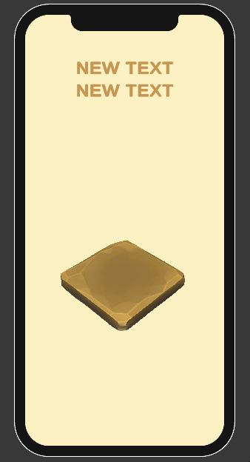
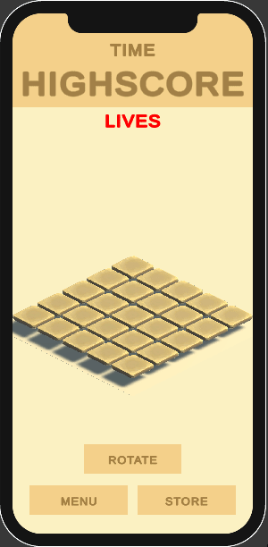
Core Features
Falling Obstacles - gif 1
Objects will fall on a randomized timer from the sky onto the tiles.
If they hit the player, it will lose a life (-1).
Tile Obstruction - gif 2
If the objects fall directly onto a tile, it will be blocked, and the player won't be able to move onto it.
Tile Clearing - gif 3
The player can clear the blocked tiles by shaking the mobile device (button just for testing)
Coin Collection
Coins will fall from the sky and land on tiles, if the player steps on the coin they will collect it and be able to use it in the in-game store, it will also add points to their score
Gif 1
Gif 2
Gif 3

Slide 5
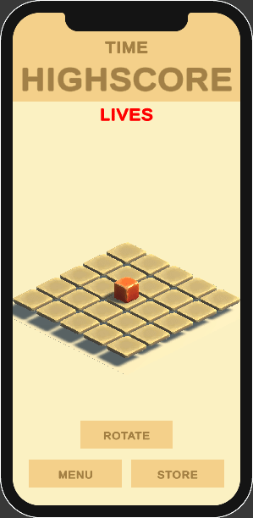
Core Mechanics/inputs
Diagonal Swipe for movement.
Double Tap for jump.
Double Tap + Diagonal Swipe for long jump.
Shake Mobile Device to rotate the Tiles and clear debris.

Slide 6
Mechanics - Extended
Double Tap + Jump
Instead of the player moving the normal 1 tile in the direction of the swipe the player will skip the first tile and jump to the second tile in the direction of the swipe, allowing the player to jump over potentially blocked tiles.
Shake Mobile Device
When the player shakes the device triggering the gyroscope inside it, the tiles will rotate upside down clearing themselves of any debris blocking them. This will launch the player in the air making it vulnerable to being hit by falling obstacles

Slide 7
API/Framework
Google Play Games Services Leaderboard API for Android
This will record a player's score and compare the score against the player's score from previous game sessions.
This will also create a leaderboard of all high scores from the player base on Android devices

Slide 8
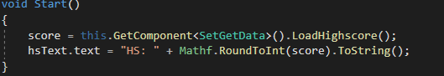
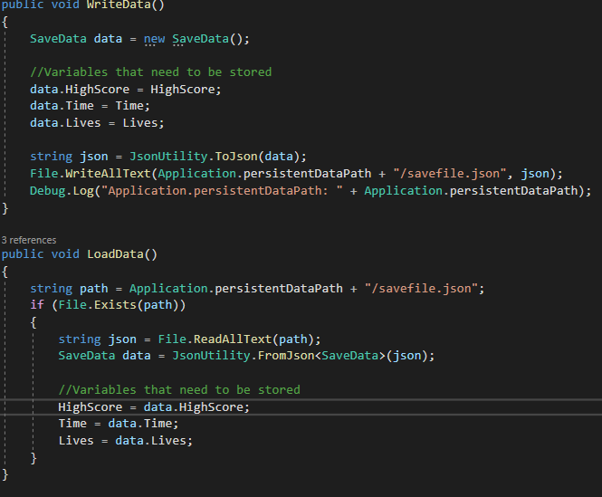
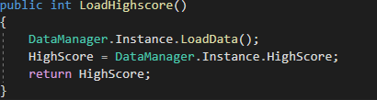
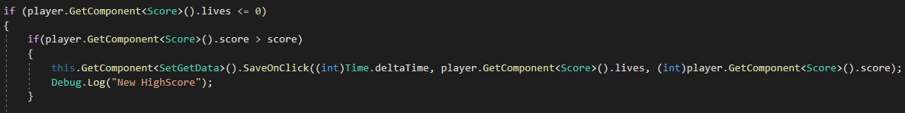
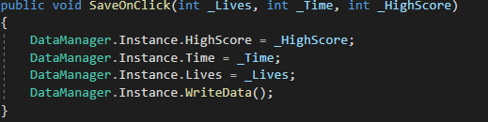
Data Persistence
Code for Highscore Loading and Saving:
Loading :
Main Json Writing and Reading Script
Saving :

Slide 9
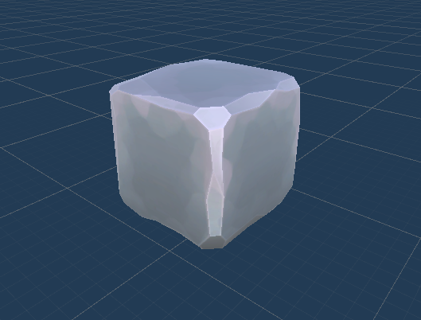
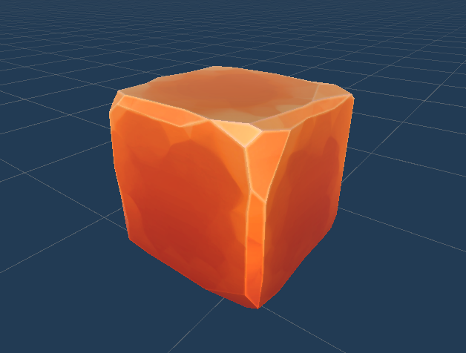
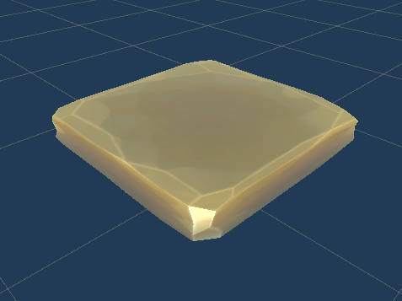
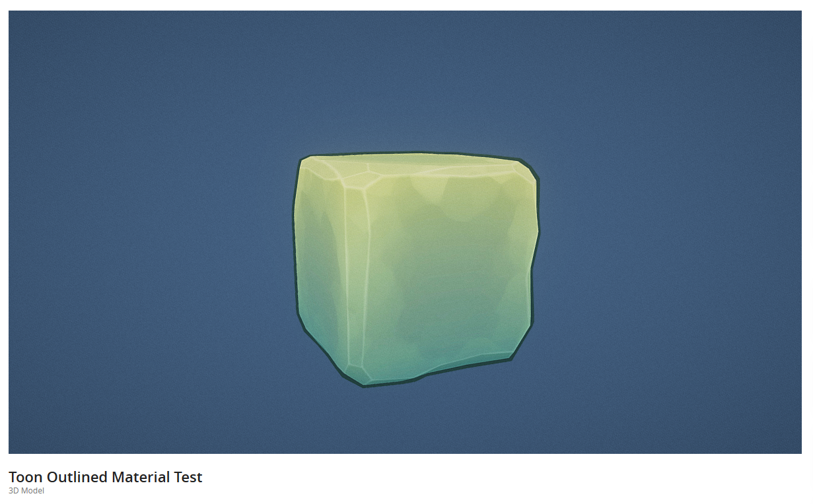
assets
For External Assets:
A customized variant of this Low Poly Cube Model is being used in the Game;
Asset Store Link : Toon Outlined Material Test - Download Free 3D model by Rocco Giandomenico (@Rocco.Giandomenico) [1760d6d] (sketchfab.com)
Obstruction
Player
Tile

Slide 10
Gameplay
Progression/Difficulty:
The longer the player last the faster the objects will fall making it harder for the player to dodge them and to clear the tiles fast enough
Purchases:
The player can use the in-game store to purchase extra lives using the coins they collect and real-world money

Slide 11
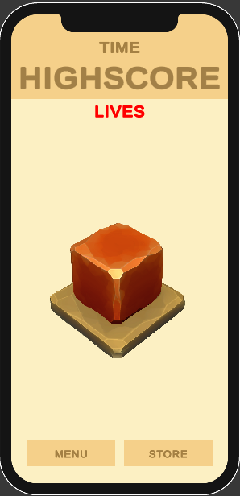
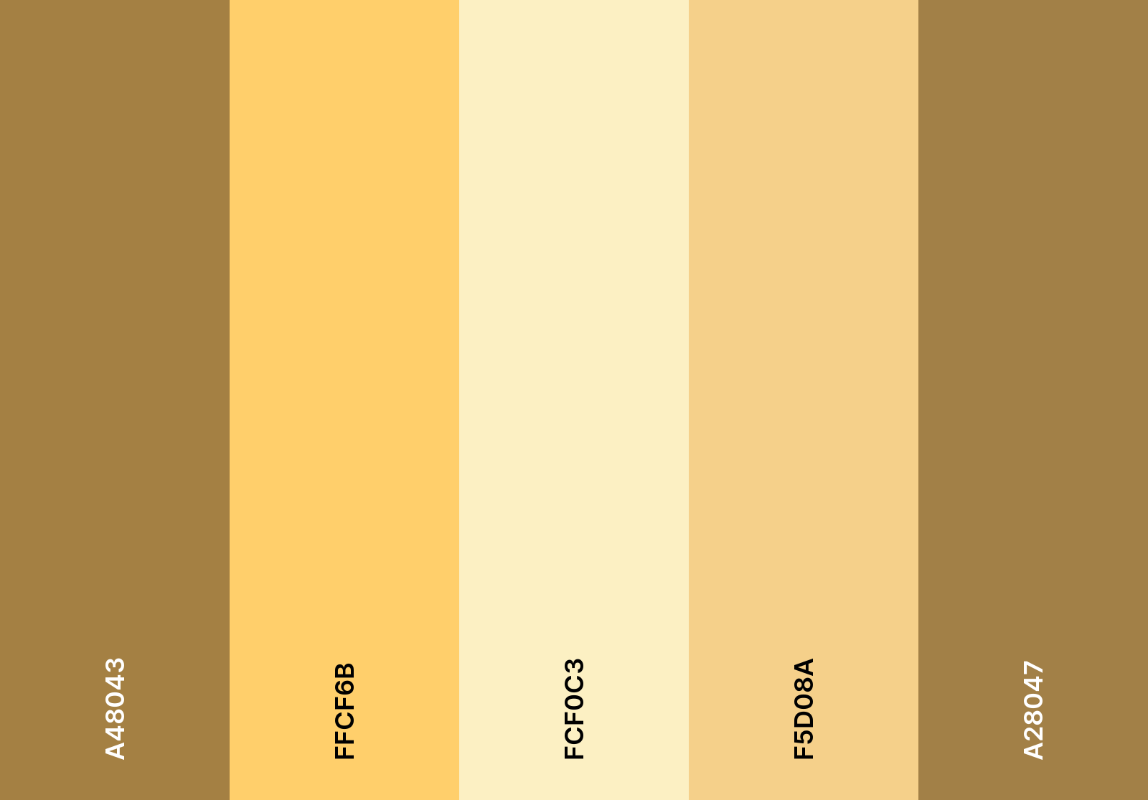
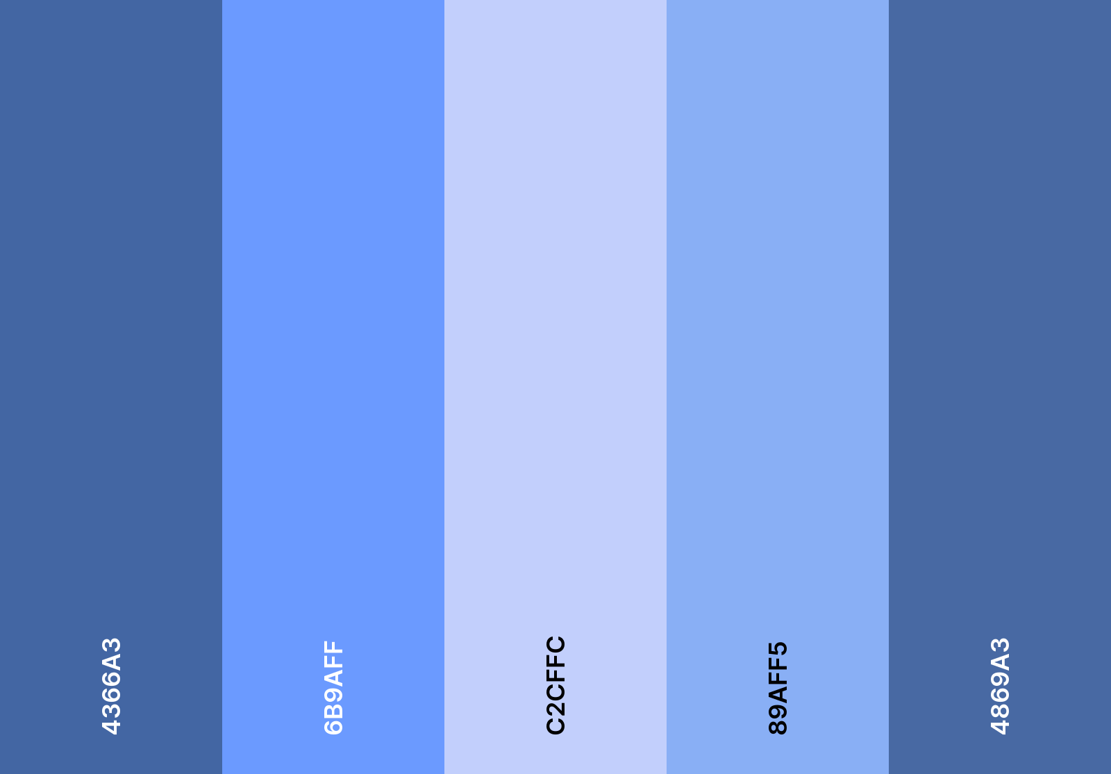
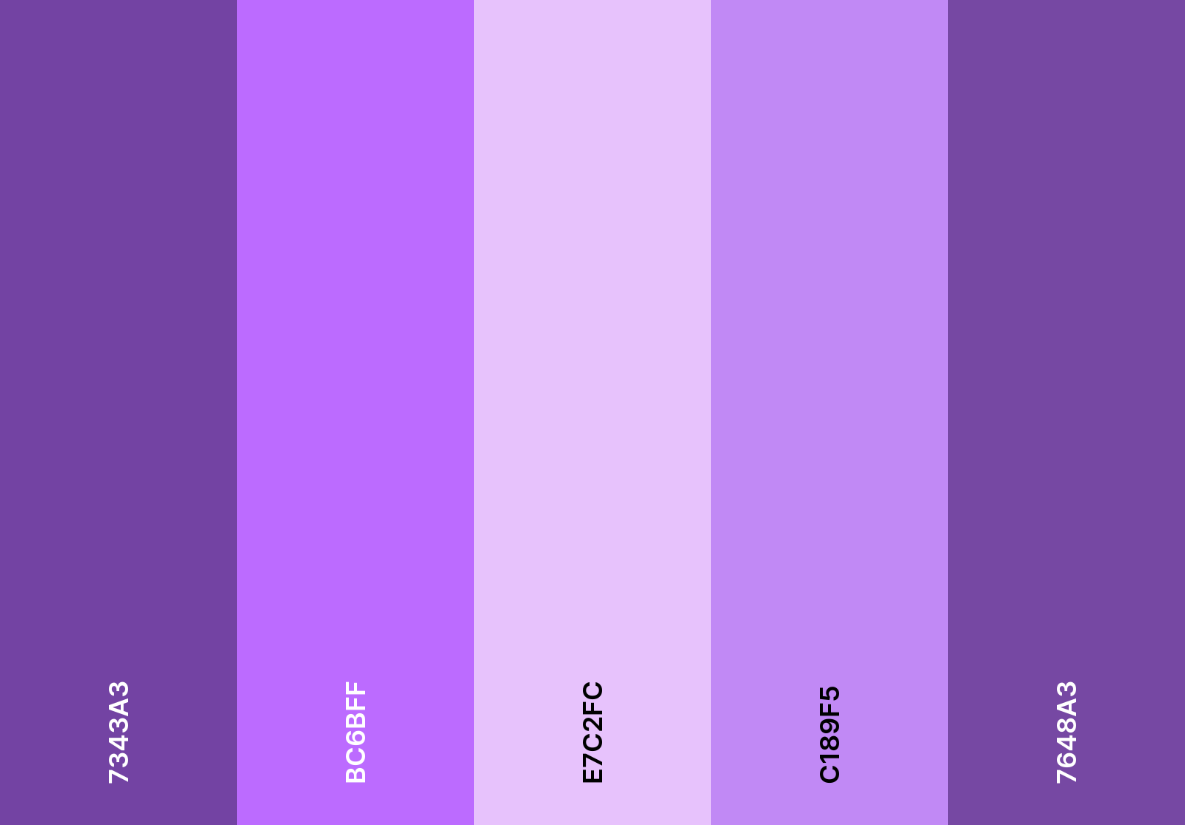
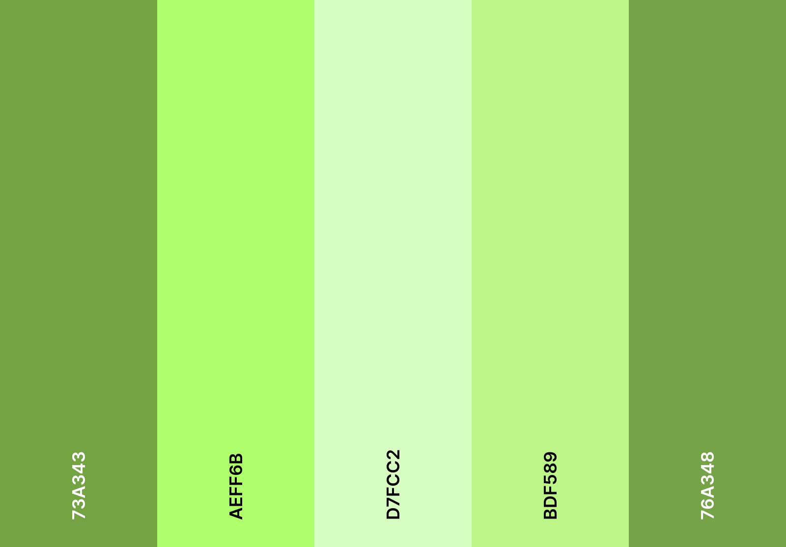
Ui and design
For the UI in the game the choice was to stay in line with other games in this genre with simplistic design where most of the buttons and option are hidden away in menus and only the essential data is being displayed
Colour Palettes for Different Themes in the Game Settings
UI Layout
Original Colour

Slide 12
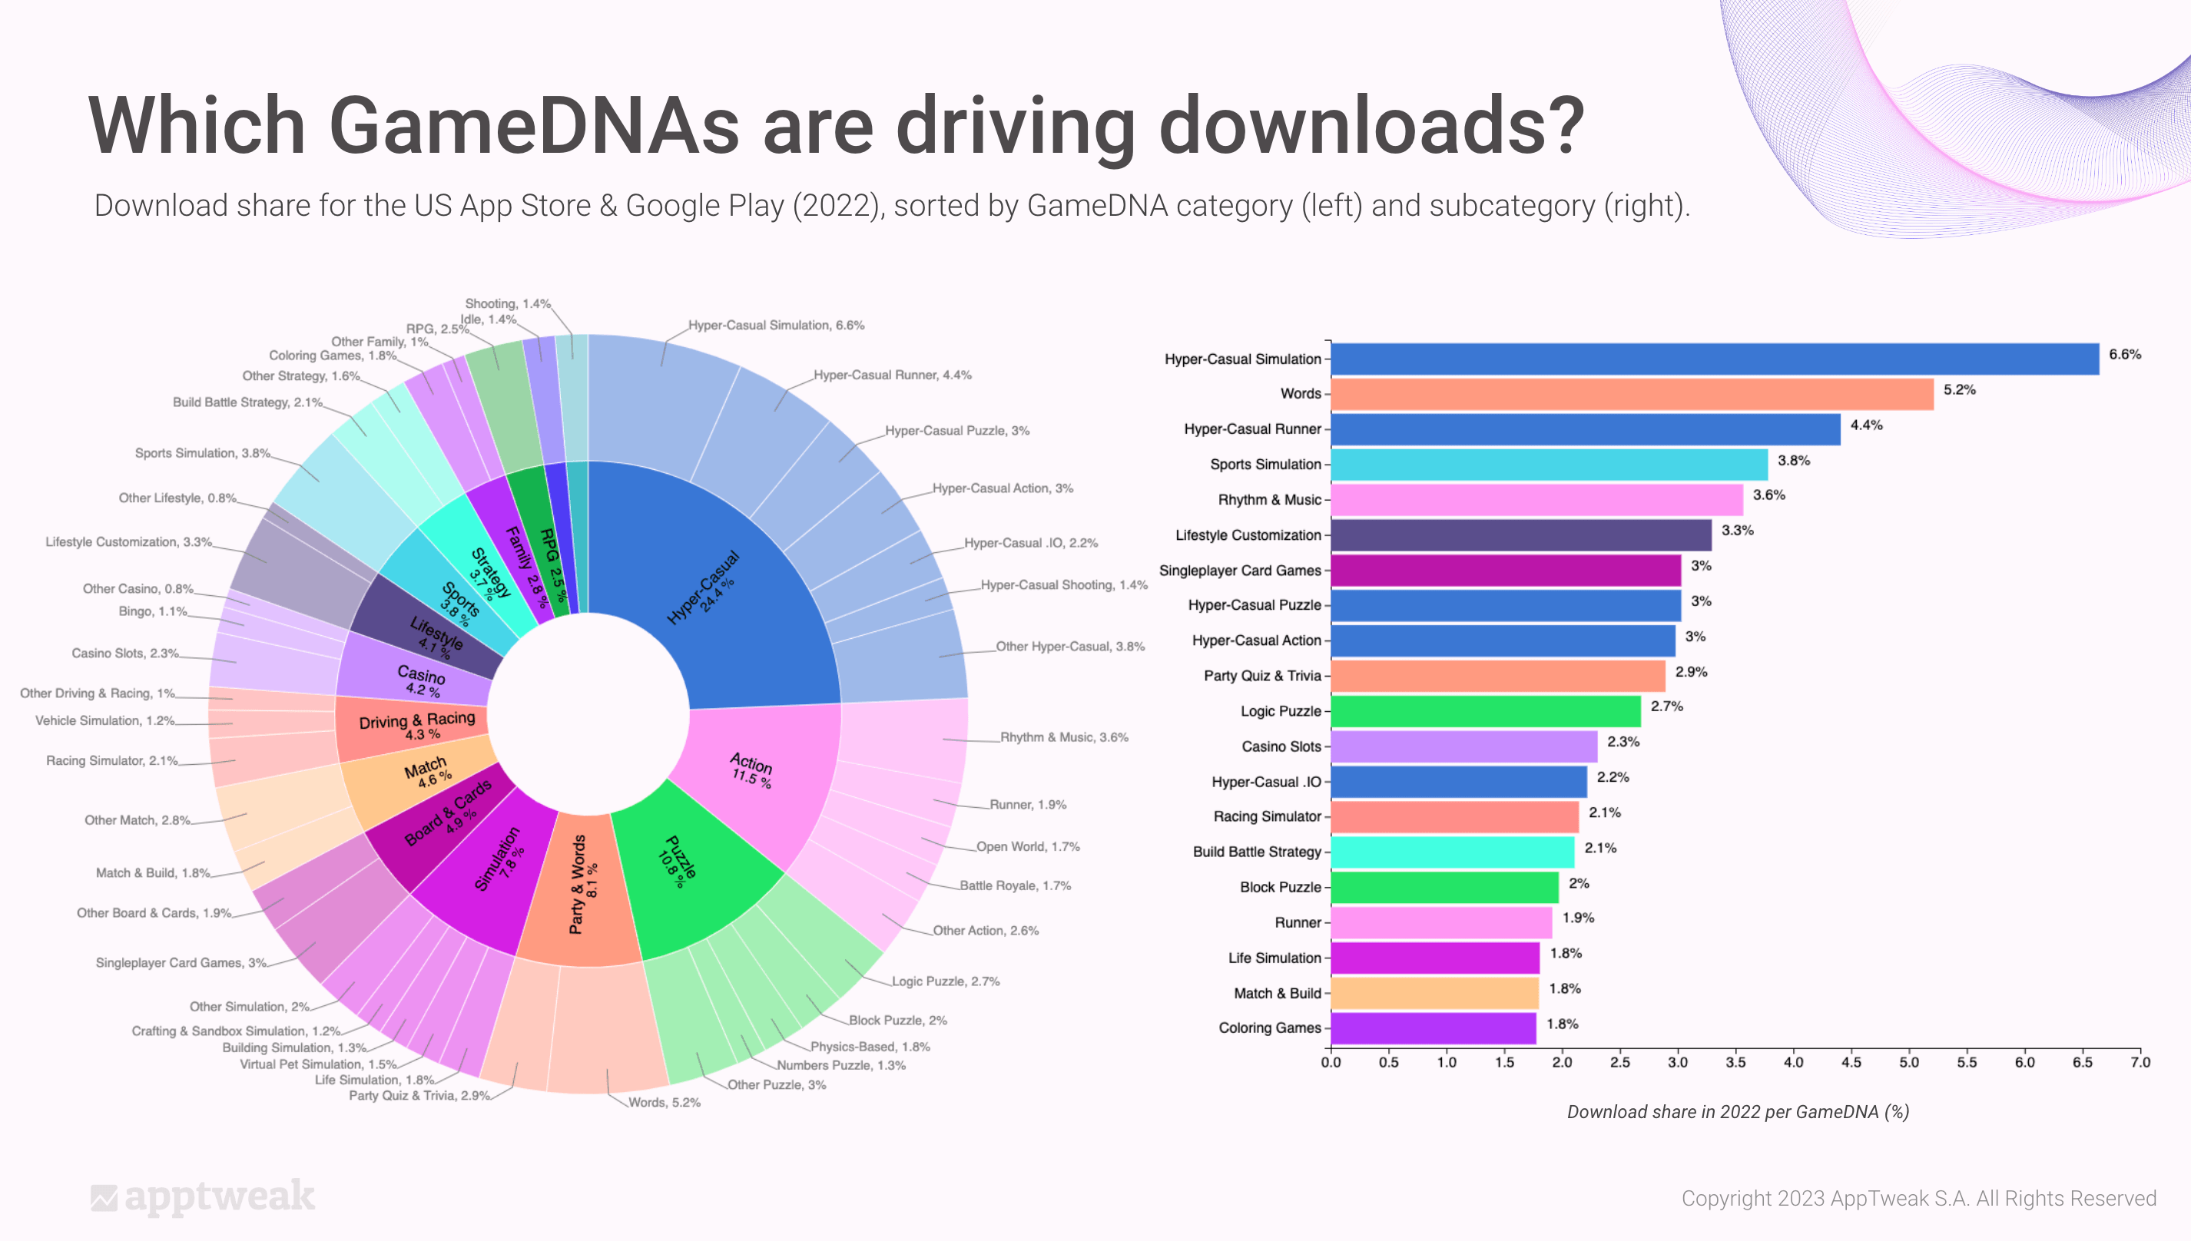
Market Research
Given Research Data From AppTweak regarding 2022, the genre with the largest market share in downloads for mobile games is HyperCasual Games.
This shows large potential of reaching a large audience, which can correlate to Revenue and Downloads.
But it can also mean saturation in the genre, decreasing discoverability inside the game store.

Slide 13
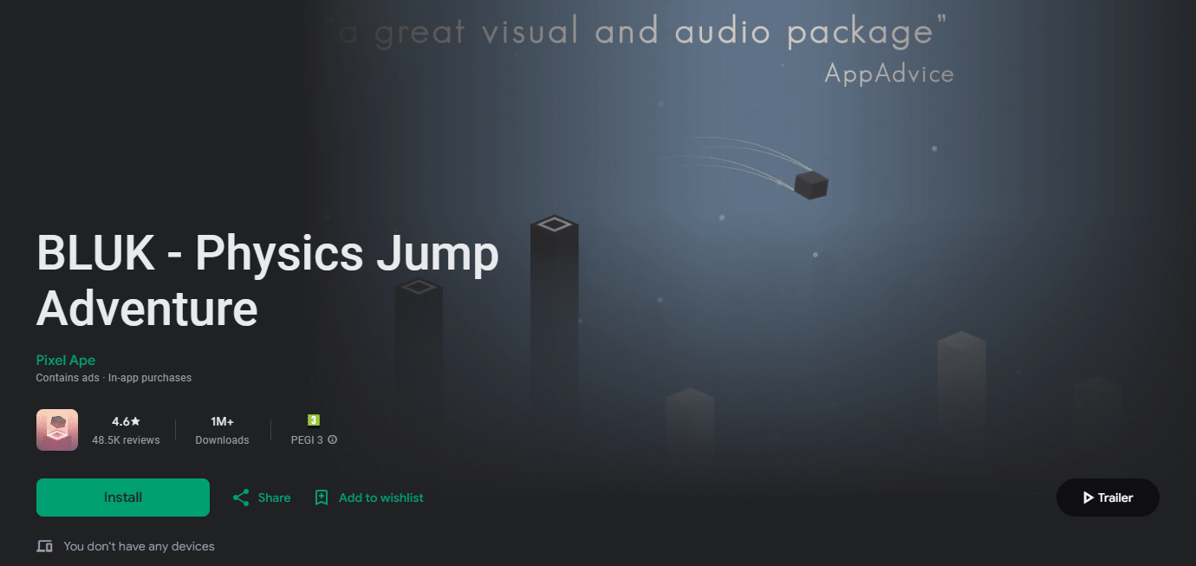
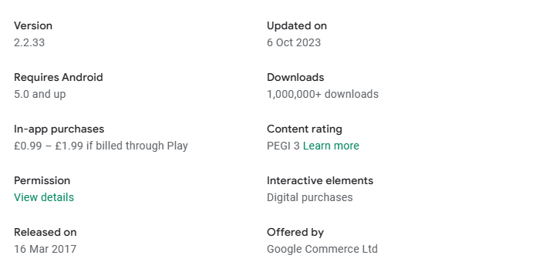
Market research - BLUK
One Game Identified in this Genre is BLUK:
Simple Graphics = In line with Genre
Simple Core Mechanics and Intuitive
High Replay ability and Difficulty Increase
Endless Adventure/ Survival Game
Good Comparison given high download numbers, similar monetization method and similar style ( cube jumping between platforms )

Slide 14
Monetization
To monetize this game, the usual mobile game monetization techniques will be employed:
Free to Play;
In-App Purchases of extra Lives and Map & Player Re-Skins;
AD for 1 extra life once player runs out. AD every time the player loses;
AD when the player closes an Active Game and then returns, with option to continue last active game as reward for watching an AD;

Slide 15
analytics
The target data to be tracked through Unity Analytics is going to be:
Data on when the player is most likely to watch an AD to continue playing;
E.g.: Score, Time Played.
Data on average playtime before engaging in In-App purchases;
Data on when the player 1st checks the store;
Data on how many times the player comes back to game before difficulty scaling becomes too low;

